Slide 1
A-LEVEL SUBSIDIARY ICT NOTES
NAJJEMBE HOMELAND SEC SCHOOL
P.O.BOX 176, LUGAZI
For inquiry
Email: lukwagoshaban820@gmail.com

Slide 2
COMPUTER SOFTWARE
Introduction to Software
System Software
Application Software

Slide 3
Unit Introduction
Computer software refers to the electronic instructions and procedures that control the operation of a computer.
Software is a sequential set of instructions given to the computer to solve a problem and to control the different operations of the computer.
Software can be subdivided into two major groups
System software
Application software

Slide 4
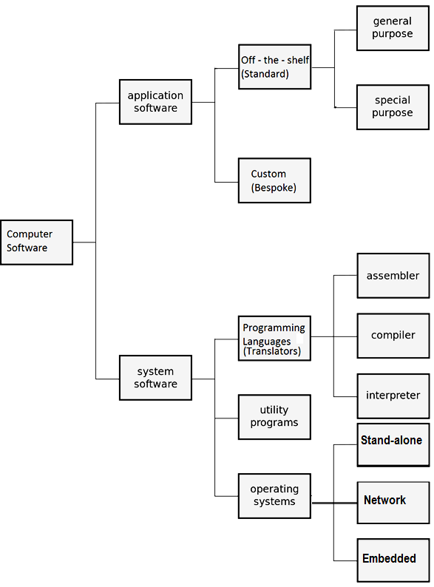
CONT…

Slide 5
SYSTEM SOFTWARE
System software refers to a category of software that enables the computer to work and as well control devices connected to it.
Or It refers the software that performs tasks related to the operation and performance of the computer system.
System software is a set of programs designed to manage operations of the computer and avail computer resources to the user.

Slide 6
Cont.…
System software is a set of programs that control or maintain all the operations of the computer and its devices, such as the CPU, communication links, and peripheral devices.
Note: System software serves as the interface between the user, the application software, and the computer's hardware.

Slide 7
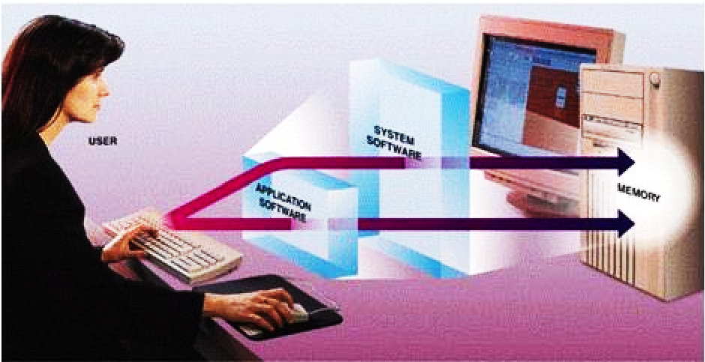
(illustration):system and application software

Slide 8
CATEGORIES OF SYSTEM SOFTWARE
There are three categories of system software.
Operating system
Utility programs
Programming
1. OPERATING SYSTEM SOFTWARE
Operating system is a type of system software that performs daily activities of a computer.
is a layer of software that takes care of the technical aspects of a computers operation.

Slide 9
Cont.…
An operating system is a generalized program that manages and coordinates all the activities taking place within a computer system.
Note: The operating system functions as a middleman between the user and the computer, as well as between application software programs and the hardware devices.

Slide 10
Device Drivers
To communicate with the hardware devices, the operating system relies on device drivers.
A device driver is a program that accepts instructions and then converts them into commands that the device understands.
Each device on a computer, such as the keyboard, mouse, monitor, printer, card reader/writer, and scanner, has its own device driver.

Slide 11
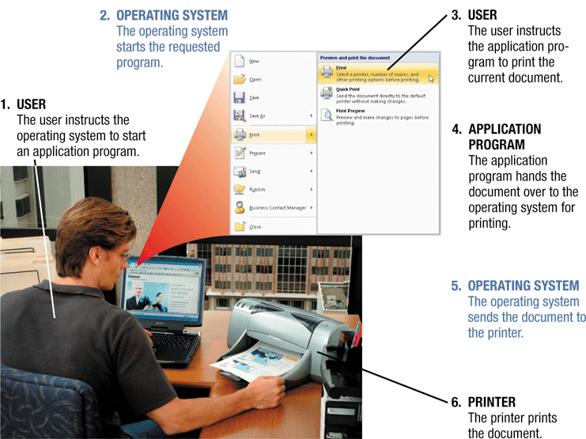
How the operating system acts as a middleman between the user, the input, processor and the output devices

Slide 12
Where does the OS reside?
In most cases, the operating system is installed and resides on the computer's hard disk.
During the boot process, usually the operating system will look first in drive C: (the designation for the hard disk drive) for the OS system files.
On handheld computers and many mobile devices such as smart phones, however, the operating system may reside on a ROM chip.

Slide 13
The Kernel of the OS
This refers to the core of an operating system, responsible for managing memory, files, and devices; maintaining the computer's clock; starting applications; and assigning the computer's resources.
Each time you turn on the computer, the kernel and other frequently used instructions in the operating system are copied from the hard disk to the computer's RAM

Slide 14
Types of operating system
Stand-alone operating system
Network operating system
Embedded operating system
Examples of Operating System Software
Windows operating system
Linux , Unix, Ubuntu Operating System
Macintosh(MAC)
Chrome operating system
Novell operating system
Android for mobile phones

Slide 15
Stand-alone operating systems
A stand-alone operating system is a complete operating system that works on a PC.
Examples of popular stand-alone operating systems include:
Mac OS X, UNIX, Linux, MS-DOS and
Windows (XP, Windows Vista, Windows 7, Windows 8, etc.).

Slide 16
Network Operating Systems
A network operating system (NOS) is an operating system that supports a network and typically resides on the server.
Some stand-alone OS systems include networking capability.
However, network operating systems are designed specifically to support all sizes of networks.
Examples of network operating systems include Windows Server 2003, 2008, Solaris, and NetWare, UNIX server, and Linux server.

Slide 17
Embedded Operating Systems
An embedded operating system is an operating system that resides on ROM chips and typically used on handheld computers and small devices.
Popular embedded operating systems today include Windows Embedded CE, Windows Mobile, Palm OS, Embedded Linux, and Symbian OS.

Slide 18
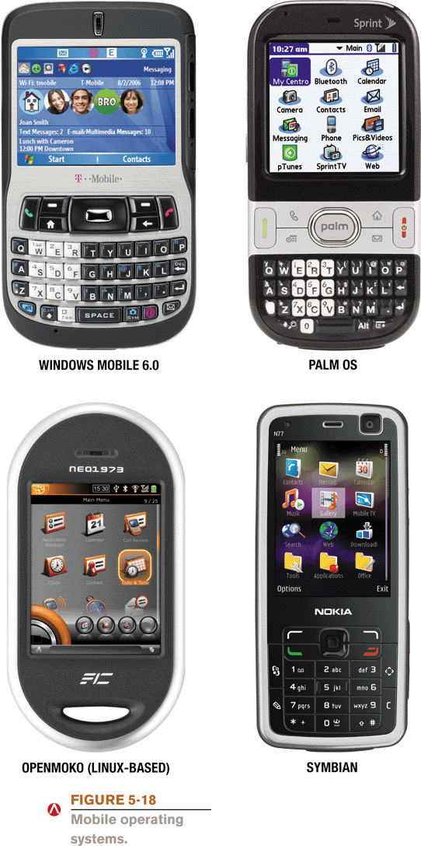
Embedded Operating Systems

Slide 19
Function of Operating System (OS)
Providing user interface
Helps in processor management e.g. multitasking and time sharing.
Control the use of peripheral devices. (Configuring devices)
Provides an environment that enables installation of application software
Controls the booting process of a computer
Monitors system performance.
Helps in administering security i.e. password making

Slide 20
CONT…
Helps in file management.
Helps in connecting devices to work with computer(configuring of devices)
Responsible for scheduling computer tasks/jobs
Helps to establish network connections.
Responsible for the memory management in that it keeps track of what memories are being used and which are free. It also keeps track of the information in a file, its location, use and status.

Slide 21
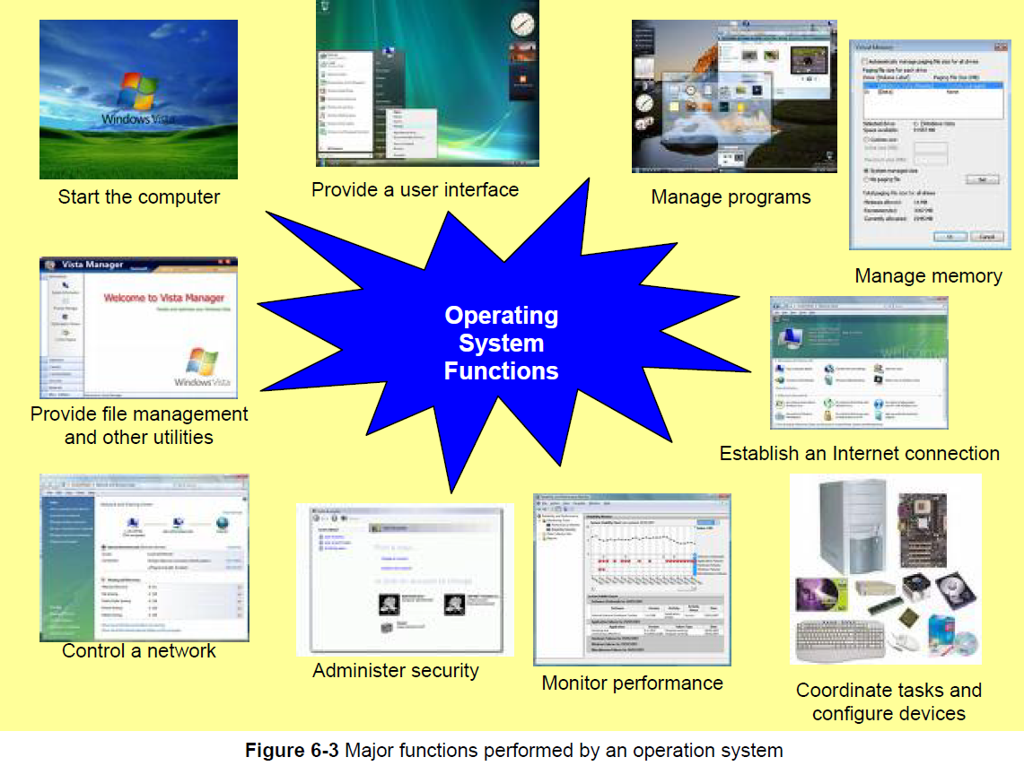
Functions of an Operating System

Slide 22
Forms of Operating System User Interfaces
There are two forms of Operating user interfaces.
Command-Line User Interface:
Graphical User interface
Command-Line User Interface:
With a command line interface, a user types keyboard or press special keys on the keyboard to enter data and instructions. The set of commands a user uses to interact with the computer is called command language. Examples are DOS, UNIX, Linux.

Slide 23
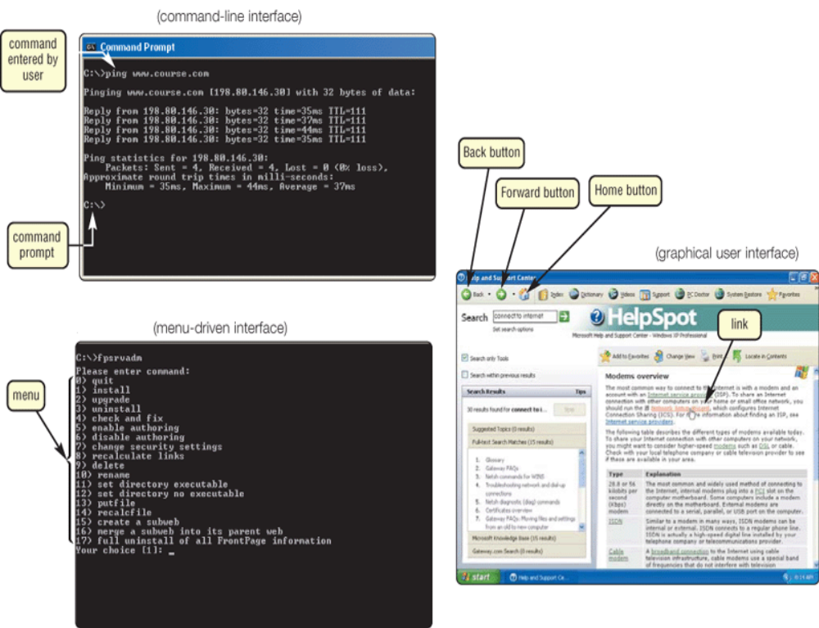
Command-line interface

Slide 24
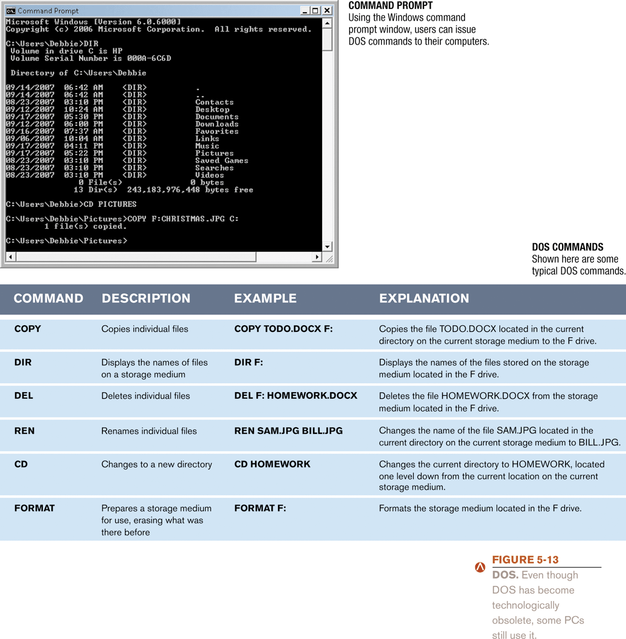
Command-line interface (cont)
Shown here are some typical CLI commands.
NB To view a list of more common commands, type help at the command prompt.

Slide 25
Advantages of Command User Interface:
Commands are executed faster.
Consumes limited Random Access Memory
Cannot easily affected by viruses
Ideal for programming and programmers
Commands can be grouped together.

Slide 26
Disadvantages of Command User Interfaces
Commands are not easily memorized
Requires a lot of knowledge to master the commands
Commands have to be typed correctly
No graphics on the screen.
A mouse cannot be used

Slide 27
Graphical User Interface (GUI)
Graphical user interface allows the user to use menus and visual images such as icons, buttons and other graphical objects to issue commands.
Advantages of Graphical User Interface (GUI)
It is user friendly because it is easy to learn and work with
There is no need to type and memorize any command language.
The interface is similar for any application.
You are provided with a Coloured screen with icons each representing a program.
A mouse may be used.

Slide 28
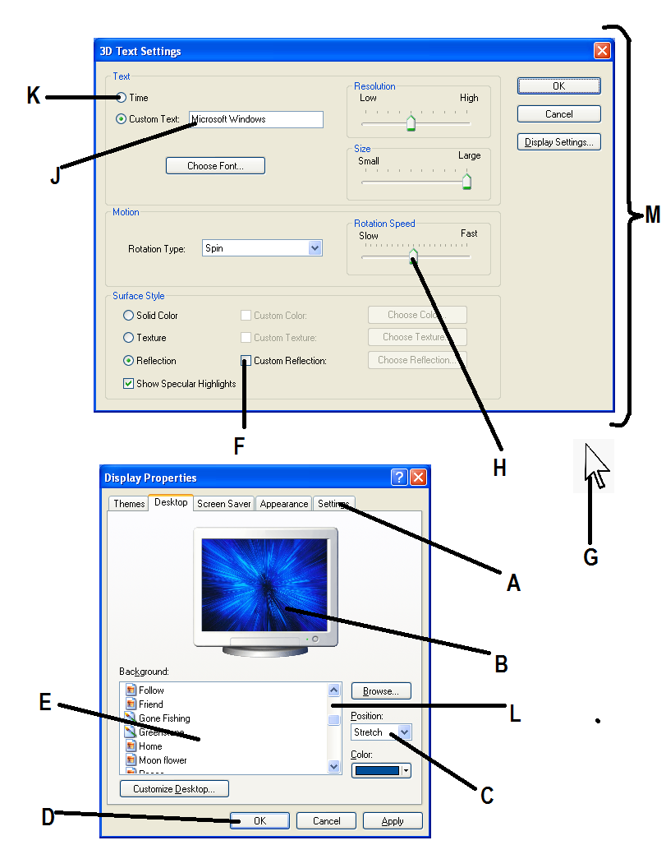
Examples of Elements/ Objects of a GUI

Slide 29
Examples of Elements/ Objects of a GUI
Icons
Command Buttons
Drop Down Lists
Check boxes
List Boxes
Dialogue boxes
Windows
Cursor
Scroll bars
Radio Buttons
Preview areas
Slider buttons
Tabs
Menus
Text boxes
Toolbars
e.t.c.

Slide 30
Disadvantages of Graphical User Interface (GUI)
Require much more memory and as well as the processor
Require much more desk space to hold the files
Difficult to automate for expert users
Easily affected by viruses
Not good for programmers.

Slide 31
Factors to consider when choosing an operating system
When choosing an operating system for a computer the following factors may be considered:
The type of computer in terms of size and make. Operating systems are available for all sizes of computers.
The hardware configuration of the computer such as the memory capacity, processor speed and hard disk capacity should meet the required minimum requirements for a the operating system to run well.

Slide 32
Factors to consider when choosing an operating system
The application software to be installed on the computer should be supported by the operating system. For example Microsoft Office 2010 cannot run on Windows 2000.
The operating system should be user friendly. This depends on the skills of the intended users of the computers.
The operating system should have adequate information and help guides for user reference.

Slide 33
Factors to consider when choosing an operating system
The cost of the operating system.
Reliability and security provided by the operating system.
The number of processors and hardware devices it can support.
The number of users it can support
The availability of basic utilities and accessory programs within the operating system.

Slide 34
Utility Software
Utility software refers to system software designed to analyze, optimize and maintain a computer in good working conditions.
Utility software usually focuses on how the computer system operates.
Performs day to day tasks related to the maintenance of the computer system.
Examples include Anti virus utility, Screen Saver utility, File compression utility, and Other utilities.

Slide 35
Functions of the Utility Programs
It detects and protects a computer against computer viruses
It reduces screen burnout (ghosting) by playing a screen saver
It increases desk space by compressing data files
It checks disk errors and sometimes fixes them
It stores the system functionality (i.e. system store)
It enables computers to sort files in order.
It enables a user to merge files
It defragments hard disks
It enables a user to encrypt files.

Slide 36
1. Anti virus utility
A computer virus, is damaging program that affects a computer negatively by altering the way the computer works without the user's knowledge or permission.
Once a virus is in a computer, it can spread throughout and damage your files and OS.
Anti virus utilities are programs that scan for computer viruses, remove, disinfect and repair damaged files.

Slide 37
2. Screen Saver Utility
SCREENSAVERS were originally designed to prevent phosphor burn-in (ghosting) on CRT monitors,
A screen saver is a program that automatically fills the computer's VDU (Visual Display Unit) with moving images or patterns when the computer is not in use.
Currently, screensavers are used primarily for entertainment, advertising or security purposes.

Slide 38
3. File compression utility
A file compression utility shrinks the size of a file. A compressed file takes up less storage space than the original file.
Compressed files, sometimes called zipped files, usually have a .zip extension.
Attaching a compressed file to an e-mail message reduces the time needed for upload and download.
When you download a compressed file, you must uncompress it to restore it to its original form.

Slide 39
Other utility software categories
BACKUP utilities can make a copy of all information stored on a disk, and restore either the entire disk (e.g. in an event of disk failure) or selected files (e.g. in an event of accidental deletion).
DATA COMPRESSION utilities output a shorter stream or a smaller file when provided with a stream or file.

Slide 40
Utility software categories (cont)
DISK CHECKERS can scan the contents of a hard disk to find files or areas that are corrupted in some way, or were not correctly saved, and eliminate them for a more efficiently operating hard drive.
DISK CLEANERS can find files that are unnecessary to computer operation, or take up considerable amounts of space. Disk cleaner helps the user to decide what to delete when their hard disk is full.
DISK COMPRESSION utilities can compress the contents of a disk to small amounts of memory. They also uncompress/ expand the compressed files.

Slide 41
Utility software categories (cont)
DISK DEFRAGMENTERS can detect computer files whose contents are broken and spread across several locations on the hard disk, and move the fragments to one location to increase efficiency.
DISK PARTITIONS can divide an individual drive into multiple logical drives, each with its own file system which can be mounted by the operating system and treated as an individual drive.

Slide 42
Utility software categories (cont)
ARCHIVE utilities output a stream or a single file when provided with a directory or a set of files. Archive suites, at times include compression and encryption capabilities.
CRYPTOGRAPHIC utilities encrypt and decrypt streams and files.
REGISTRY CLEANERS clean and optimize the Windows registry by removing old registry keys that are no longer in use.

Slide 43
Utility software categories (cont)
FILE MANAGERS provide a convenient method of performing routine data management tasks, such as deleting, renaming, cataloging, moving, copying, merging, generating files and modifying data sets.
MEMORY TESTERS check for memory failures.
NETWORK utilities analyze the computer's network connectivity, configure network settings, check data transfer or log events.

Slide 44
Utility software categories (cont)
A SPYWARE REMOVER is a utility that detects and deletes spyware and other similar programs.
Spyware is a program placed on a computer without the user's knowledge that secretly collects information about user, often related to Web browsing habits.
INTERNET FILTERS are utilities that remove or block certain items from being displayed.
Four widely used filters are anti-spam programs, Web filters, phishing filters, and pop-up blockers.

Slide 45
Utility software categories (cont)
SYSTEM PROFILERS provide detailed information about the software installed and hardware attached to the computer.
SORTING UTILITY for organizing files in any chosen order.
MERGE UTILITY for Merging or combining different files in one.
HEX EDITORS directly modify the text or data of a file a program.

Slide 46
Utility software categories (cont)
A SEARCH UTILITY is a program that attempts to locate a file on your computer based on criteria you specify.
A PERSONAL FIREWALL is a utility that detects and protects a personal computer from unauthorized intrusions.
An UNINSTALLER is a utility that removes a program, as well as any associated entries in the system files.

Slide 47
Utility software categories (cont)
A DIAGNOSTIC UTILITY compiles technical information about your computer's hardware and certain system software programs and then prepares a report outlining any identified problems.
SYSTEM MONITORS for monitoring resources and performance in a computer system.
… e.t.c….

Slide 48
Programming Languages
A programming language is a notation for writing computer software.
Refer to the languages used to write a computer instruction, program software. A person who writes a program is called a programmer
NB: Examples of popular programming languages include:
FORTRAN (FORmular TRANslator)
BASIC (Beginners' All-purpose Symbolic Instruction Code)
Visual BASIC
COBOL (COmmon Business-Oriented Language)
C and C++
Pascal, Perl, Java e.t.c

Slide 49
Functions of Software Programmer
He writes a computer program
He maintains a computer program
He upgrades a computer
TYPES OF PROGRAMMING LANGUAGES
Programming languages are of two types
Low level programming language
High level programming language

Slide 50
Low level languages
This is a computer program written in machine code language, the language understood by a computer. It is also referred to as binary language because it consists of only two digits. The digits of 0s and 1s
Types of low-level languages
Machine code language (First generation)
Assembly language (Second generation)

Slide 51
Assembly (low-level) languages
This is a language which consist of mnemonic symbols (English like words) used to represent the binary digits of zeros and ones of machine language. Assembler languages are used to develop system software.
However computers can only understand machine language, thus assembler languages must be translated into machine language for execution

Slide 52
Cont.…
Advantages of Low level languages/Machine code
Machine code program are executed faster.
They don't require either a compiler or interpreters except assembly
They are suitable to developing operating systems.
Disadvantages of Low level languages
They are difficult to learn and understand.
The instructions are expressed in binary form ( 0 and 1s)
The programs are machine dependent hence difficult to be used by other machines of different family.

Slide 53
High level programming languages
This is a computer program written in official language (known to man) but should be converted to machine code for a computer to understand.
High level languages consist of statements or sequences text including words, numbers and punctuation, much like written natural languages.

Slide 54
Cont.….
Advantages of High level Languages
They are machine independent and can be used by other computers.
They are user friendly and problem oriented.
They are easier to learn, write, correct and revise than assembler and machine languages.
They can be used for development of application software.
Disadvantages of High level Languages
They require to be translated to machine code
They are not executed faster.

Slide 55
Examples of High level languages
COBOL
PASCAL
Python
Java Script
Java
C
Ruby
C++
C#(C-sharp), PERL, FORTRAN.

Slide 56
LANGUAGE PROCESSORS/TRANSLATORS
Language processors: These have to translate high level languages to machine code languages which the processor can understand. They are software designed to translate from high level language to low-level language.
Examples of language processors
A compiler: a compiler is a program which translates a whole source program from high level language to low level language which can easily be understood by the computer.

Slide 57
CONT…
An interpreter: This is a program that translates the source program line by line while the program is running from high level language to low level language.
The assembler: This translates assembler instructions from assembley language to machine code language or the binary code.
The linkers: These combine compiled programs and determine where the program will be located in the memory

Slide 58
Language editors
These are applications/software used to write computer language/codes. Some also compile.
Examples of language editors
Notepad
Trouble c
Borland
Sublime Text
Dev C, C++
CodeBlocks
Notepad ++

Slide 59
Common terms used in programming
Source code: is a program instruction written as text file by the programmer that must be translated by a compiler or interpreter or assembler into an object code before execution.
Source code cannot be understood by the computer until it has been translated into machine code.
Execution: is the process by which a computer system performs the instructions of a computer program.
Object code: is a program code in machine language that is ready for execution by the computer.
Bug: is a logical problem in the program source code that stops the program to give wrong results/ from running
Debugging: is the process of detecting, checking and identifying problems and errors in the source code.

Slide 60
APPLICATION SOFTWARE
This is a software program that performs a specific end user function. Application software is installed on operating system.
Application software consists of programs designed to perform specific tasks for end-users. For example typing a letter.
Application software is a set of programs designed to handle or solve specific tasks for a user

Slide 61
CLASSIFICATIONS OF APPLICATION SOFTWARE
The common Classifications of application software include:
Off-the-shelf (standard) software,
Custom (bespoke) software,
Shareware, Freeware,
Open-source, Public-domain software,
Web-based software, copyrighted software,
Special Purpose and General purpose.

Slide 62
OFF-SHELF SOFTWARE
These are programs already written and ready to be run upon their purchase.
This refers to packaged software that is designed to meet the needs of a wide variety of end users.
Off the shelf software is mass-produced, commercially sold software, and copyrighted.
Microsoft Office Word and Adobe Photoshop are examples of Off the shelf software.

Slide 63
Main categories of off shelf packages
Word processors
These are programs that enable you to perform word processing functions, they are document production applications.
Word processing software
An application software with which a user creates, edits save, format And print letters reports and other documents. E.g. word processing software, EZ word, word perfect etc
Spreadsheet software
An application with which a user can organize data in rows and columns create graphs and can perform calculations e.g. Ms excel, Lotus 123, VisiCalc

Slide 64
Cont.…
Presentation software
An application with which a user can organize content on a slide for viewing by the audience. Ms power point, Harvard graphics, Corel presentation
Database software
An application with which one can store lots of data for future manipulation
Desktop publishing software
Application software with which one can design publications like news papers, wedding cards certificates etc
Imaging software: application software with which one can edit, retouch a photograph.

Slide 65
Cont..
Web browsing software
Web browsing software used for displaying and viewing webpages from the internet or html documents on computers.
Examples Include:
Mozilla Firefox,
Internet Explorer
Safari
Opera
Netscape Navigator
Chrome

Slide 66
Cont..
Web authoring software – These are used by webmasters for building websites. Examples include:
Microsoft FrontPage,
Adobe Dreamweaver,
Microsoft Expression Web, Antenna Web Design Studio, Sublime text 3
Media Players for Audio and Video
Media Players for Audio and Video playback on computers.
Examples include:
Windows Media Player, Nero Showtime,
Jet-Audio, Power DVD, VLC Media Player Virtual DJ, etc.

Slide 67
Cont..
Graphics software – Used by graphic designers
to create and design artistic graphics and to manipulate visual images on a computer such as logos, cartoons etc.
Examples include
Paint, Adobe Photo shop, Corel Draw, Adobe Illustrator etc.
Accounting software
Accounting software helps companies to record and report their financial transactions. With accounting soft-ware, you perform accounting activities related to the general ledger, accounts receivable, accounts payable, purchasing, invoicing, job costing, payroll functions, etc. Examples include Quick Books

Slide 68
Cont..
Audio and video editing software
Audio editing software lets users produce studio quality soundtracks. With video editing software, you can modify video clips: you can reduce the length of a video clip, reorder a series of clips, or add special effects such as words that move horizontally across the screen etc.
Examples
Adobe Premier Video Editor
Ulead Video Editor
Adobe Audition for –audio
Fruity Loops Studio-audio

Slide 69
Cont.…
Images viewing software
This refers to computer applications primarily used for previewing digital photographs on the computer screen.
Many have basic features such as viewing thumbnails, slideshows, printing and simple editing such as cropping and resizing.
Examples of Image viewers include: Microsoft Office Picture Manager, Windows Photo viewer, Picasa photo viewer, etc.

Slide 70
Cont.…
Reference software
Reference software provides valuable and thorough information for all individuals. Popular reference software includes encyclopedias, dictionaries, health/medical guides, and travel directories.
Examples include: Encyclopaedia Britannica 2011 Ultimate Reference DVD
Microsoft Student with Encarta Premium, e.t.c.

Slide 71
Cont..
Note Taking software
Note taking software enables users to enter typed text, handwritten comments, drawings, or sketches anywhere on a page and then save the page as part of a notebook .The software can convert handwritten comments to typed text or store the notes in handwritten form. Examples include Microsoft Office OneNote

Slide 72
Cont..
Text Editors
Text editors are simple word processors that are generally used to type without any special formatting. Text editors are mainly used to create small notes, memos and programs. Examples of common text editors are: Notepad,
Notepad++, Sublime Text, Gedit etc.
Gaming Software
These are programs developed as electronic game that involve human interaction with a user interface to generate visual feedback on a computer.
Common computer games include solitaire, chess titans, Racing, StarCraft, Need for Speed, GTA Vice City, and Alien Shooter.

Slide 73
Cont..
Email Software / Email client
Email software (Commonly known as email client) is a computer program used to access and manage a user's email account.Web applications that provide message management, composition, and reception functions are sometimes also commonly referred to as webmail.
Popular locally installed email clients include Microsoft Outlook, Pegasus Mail, Mozilla's Thunderbird, KMail, Evolution and Apple Mail. Popular web-based email clients include: GMail, Yahoo! Mail, mail.com, Lycos mail, and Hotmail.

Slide 74
Advantages of off-shelf packages
They are relatively cheaper than bespoke packages.
They are readily available for purchase.
They are user friendly; many have a graphical user interface, sample manuals provided on purchase.
The user does not face research and development costs or problems since the package is already in operation.
The user faces limited risk since the user has an option to seek information from existing users about the package before making a decision to purchase.

Slide 75
Disadvantages of off-shelf packages
They hardly full fill users' specific needs perfectly.
They are standardized implying it may be hard to make adjustments.
They may not be recommended where a particular company wants to gain competitive advantage over others.
Where the package does too much compared to the company needs, the amount of extra space occupied in the hardware can lead to memory wastage.
The package may also be limited to a particular operating system like Microsoft Office for Windows operating system.
It may be easy to manufacture viruses that may tamper with such application programs.

Slide 76
CUSTOMIZED/TAILOR-MADE/BESPOKE PROGRAMS
Custom software is tailor-made software, which is developed at a user's request to perform specific functions
These are tailor made programs constructed to meet specific user requirements.
Is program developed by an individual or a small company to meet the needs of a specific organization that might have hired them.
They are specifically designed to meet user requirements

Slide 77
Merits of customized programs
Ability to satisfy user's specific needs
The company will be able to perform tasks with its software that its competitors cannot do with theirs thereby gaining a competitive advantage.
They can easily be modified or upgraded.
Ownership is to the company that ordered for the software.

Slide 78
Disadvantages of customized software
Time taken to develop the package may be long yet requirements could be urgent.
The cost of paying programmers makes them expensive. The organisation has to incur development and consultancy costs in this case.
They are not flexible i.e. not meant to do various tasks.
They are expensive to maintain. When they breakdown programmers who are expensive have to be called in

Slide 79
Cont..
In-case of breakdown, the company may be brought to a standstill
There is a greater probability of bugs in bespoke programs.
They are not compatible with all computer types i.e. they are designed for specific computer types.
The program may not run which means that the programmer has to design another one. This could even lead to more costs on the side of the user as well as causing delays

Slide 80
Comparison of the characteristics Standard and Custom Software
STANDARD SOFTWARE IS… | CUSTOM SOFTWARE IS…
1. Easy to use, because it is known by many people. | 1. Unique, and requires extensive training before use.
2. Cheaper because it is massively produced and packaged for commercial purposes. | 2. Expensive because it requires hiring a programmer.
3. Easy to acquire because it is already made. | 3. Difficult to acquire due to the time needed for programming it.
4. More reliable because it is tried and well tested by many users. | 4. May contain programming errors since it is not tested adequately.
5. Containing online help to guide users in case of any problems in use. | 5. Usually lacking online help services.
6. Can not be modified or changed to meet unique user requirements. | 6. Meets all user requirements and can be edited if need arises.

Slide 81
Shareware
Shareware is copyrighted software that is distributed at no cost for a trial period.
To use a shareware program beyond that period, you send payment to the program developer. In some cases, a scaled-down version of the software is distributed free, and payment entitles the user to the fully functional product.

Slide 82
Copyrighted software
Copyrighted software refers to computer programs with restrictions regarding use, modification, and redistribution.
You have to pay for copyrighted software and must not copy it without permission from the manufacturer.
Copying copyrighted software without paying for it is clearly unethical and illegal.

Slide 83
Freeware
Freeware is copyrighted software provided at no cost by an individual or a company that retains all rights to the software.
Therefore, other programmers cannot include freeware in applications they intend to sell.

Slide 84
Open-source,
Open source software is software provided for use, modification, and redistribution. This software has no restrictions from the copyright holder.
Open source software usually can be downloaded from the Web at no cost.

Slide 85
Public-domain software,
Public-domain software has been donated for public use and has no copyright restrictions.
Anyone can copy or distribute public-domain software to others at no cost.

Slide 86
Web-based software,
Web-based software refers to programs hosted by a Web site.
Users access and interact with Web-based software from any computer or device that is connected to the Internet.
Many Web sites allow free access to their programs; some charge a fee.
Examples of Web-based software include e-mail, Website builders, online games, travel and mapping software ,e.t.c.

Slide 87
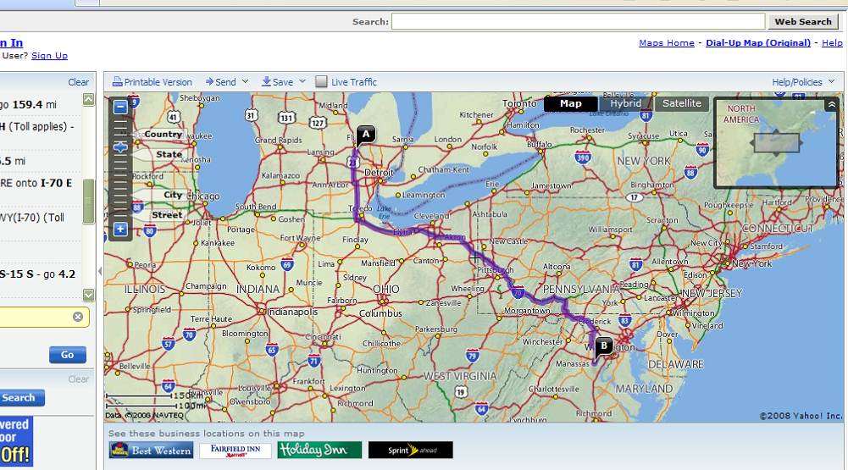
Web-based software

Slide 88
Special Purpose (Specialized) Software
This refers to computer programs developed and dedicated to accomplish particular jobs only.
Programs that run on special purpose computers like ATMs are special purpose software.
Other Examples of specialized software include:
Business – Transaction and Sales Management software.
Science and Engineering software etc..

Slide 89
General purpose
This refers to a Wide a variety of application programs that perform many common tasks.
Varieties of General purpose application programs include Word processing programs, Spreadsheet programs, web browsers, Graphics programs, etc.

Slide 90
Software Suites
A software suit is a collection of individual application soft-ware programs sold as a single package.
When you install the suite, you install the entire collection of applications at once instead of installing each application individually.
At a minimum, suites typically include the following software applications: word processing, spreadsheet, database, and presentation graphics,

Slide 91
POPULAR SOFTWARE SUITES
SUITE NAME | Word Processor | Spreadsheet | Presentation Program | Database Management Software
Lotus Smart Suite | Lotus Word Pro | Lotus 1-2-3 | Lotus Freelance Graphics | Lotus Approach
Microsoft Office | Microsoft Word | Microsoft Excel | Microsoft PowerPoint | Microsoft Access
KOffice | KWord | KSpread | KPresenter | Kexi
OpenOffice.org | OpenOffice.org Writer | OpenOffice. org Calc | OpenOffice. org Impress | OpenOffice. org Base
WordPerfect Office | WordPerfect | Quattro Pro | Corel Presentations | Corel Paradox

Slide 92
POPULAR SOFTWARE SUITES
SUITE NAME | Word Processor | Spreadsheet | Presentation Program | Database Management Software
Celframe Office | Celframe Write | Celframe Spreadsheet | Celframe Power Presentation | Celframe Data Access
Ability Office | Ability Write | Ability Spreadsheet | Ability Presentation | Ability Database
Kingsoft Office | Kingsoft Writer | Kingsoft Spreadsheets | Kingsoft Presentation | (None)
Apple iWork | Apple Pages | Apple Numbers | Apple Keynote | (None)

Slide 93
Advantages of using software suites
Costs significantly cheaper than buying each of the application package separately
Easy to learn and use because applications within a suite usually use a similar interface and share common features such as clip art and toolbars.
Easy installation because all the various applications can be installed at once.

Slide 94
Common Terminologies used in Software
Software license
This is a document that provides legally binding guidelines for the use and distribution of software.
Software agreement
This refers to the legal contact between licensor and /or author and the purchaser of a piece of software which establishes the purchaser's' rights.
Software piracy This is the illegal duplication of copyrighted software.
Software bug refers to an error in the programming code that does not permit it to function well.

Slide 95
Common Terminologies used in Software
Beta software is a type of software provided to people for testing purposes.
Software release is the process of issuing/letting the software or application for publication, use and distribution.
Software version refers to variation of an earlier or original type with minor changes to the existing version or type. Eg. ITunes 12.0, ITunes 12.2.3
Hot fix: This is a software program that is designed to fix a bug or security hole in software program.

Slide 96
Common Terminologies used in Software
Spy ware: This is a software application that is designed to gather information about a person or organization without their knowledge that may send such information to another entity.
Software Patch: This is a software program that is designed to modify, correct, and fix problems in software.
Software update: This is a software application that provides fixes for features that are not working as intended or adds minor software enhancements and compatibility

Slide 97
Common Terminologies used in Software
Software upgrade: This is a process of replacing a product with a newer version of the same product.
Firmware: This is a permanent software that is programmed or embedded in a hardware usually read-only-memory by the manufacturer.

Slide 98
Factors to consider before obtaining a software program
correctness — the software should do what it is supposed to do, according to the design specifications.
robustness — the software should be stable, and it should respond well to unexpected conditions e.g. wrong input.
user-friendliness — the software should be easy to use by users from the intended audience.
adaptability — the software should be easy to customize/modify to adjust to the needs of the user.

Slide 99
Factors to consider before obtaining a software program (cont)
reusability — the parts of the software code should be easily reused to build other programs.
interoperability — the software should be able to interface with other software systems.
efficiency — the software should make good use of its resources i.e. (memory, disk, CPU, network)
portability — the software should be easy transfer from one system to another.
security — the software should be able to protect the information it is responsible for.

Slide 100
Characteristics of Good computer software
...provides the required functionality.
...is usable by real (i.e. simple) users.
...is predictable, reliable and dependable.
...functions efficiently.
...has a "life-time" (measured in years).
...provides an appropriate user interface.
...is accompanied by complete documentation.
...can be easily customized/configured.
...can be "easily" maintained and updated.

Slide 101
Qualities of good computer software.
What the software producer wants
What the software consumer wants:
Cheap to produce
Well-defined behaviour
Easy to "sell"
Easy to maintain
Reliable
Easy to use
Flexible
Quick to produce
Cheap to buy
Easy to learn
Easy to use
Solves the problem
Reliable
Powerful and Fast
Flexible
Available (easy to obtain)
Learning Aids and Support Tools like Help, Templates and Wizards

Slide 102
Factors to consider before obtaining a software program
correctness — does the software do what it is suppose to do (according to the design specs)?
robustness — how does the software respond to unexpected conditions (wrong input)?
user-friendliness — is the software easy to use by users from the intended audience?
adaptability — how difficult is it to modify the software to adjust to an ever-changing world?

Slide 103
Factors to consider before obtaining a software program (cont)
reusability — can parts of the software be easily reused to build other software systems?
interoperability — does the software interface with other software systems?
efficiency — does the software make good use of its resources (memory, disk, CPU, network)?
portability — can the software to easily ported (moved) to other operating
security — does the software protect the information it is responsible for?

Slide 104
Cont..
Suitability. This is the essential Functionality characteristic and refers to the appropriateness (to specification) of the functions of the software.
Accurateness. This refers to the correctness of the functions, an ATM may provide a cash dispensing function but is the amount correct?
Interoperability. A given software component or system does not typically function in isolation. It concerns the ability of a software component to interact with other components or systems.

Slide 105
Cont..
Compliance. Where appropriate certain industry (or government) laws and guidelines need to be complied with. This s addresses the compliant capability of software.
Security. This relates to unauthorized access to the software functions.
Fault tolerance. The ability of software to withstand (and recover) from component, or environmental, failure.
Understandability. Determines the ease of which the systems functions can be understood, relates to user mental models in Human Computer Interaction methods.

Slide 106
Cont..
Learnability. Learning effort for different users, i.e. novice, expert, casual etc.
Maintainability. Characterizes the amount of effort to change a system.
Stability. Characterizes the sensitivity to change of a given system that is the negative impact that may be caused by system changes.
Replace ability. Characterizes the plug and play aspect of software components, that is how easy is it to exchange a given software component within a specified environment.

